Slide 1

DF Coaching
A web application for coaching and scorecard process automation

Slide 2

Table of Contents
Scope & Limitation
Process Workflow
Components

Slide 3
Scope
Limitations
Accurately display scorecard item and its actual score depending on the agent’s role
Add/modify existing scorecard item details for every roles
Display team data of leaders
Display the current score standing of agents
Simulate data for opportunities
Manage the sessions per week
Summarize weekly coaching data
Highly dependent on Excel file when displaying score data
Excel file must be reformat as (*.xlsx) file and convert all formulas to values
Excel file containing score data must be updated daily to reflect the data displayed for the users
Cannot dynamically add another session type (Scorecard, Coaching, Triad, Meeting, Heartbeat, etc..)
Updating the format of the session documents actually cause the system to revise its process flow

Slide 4
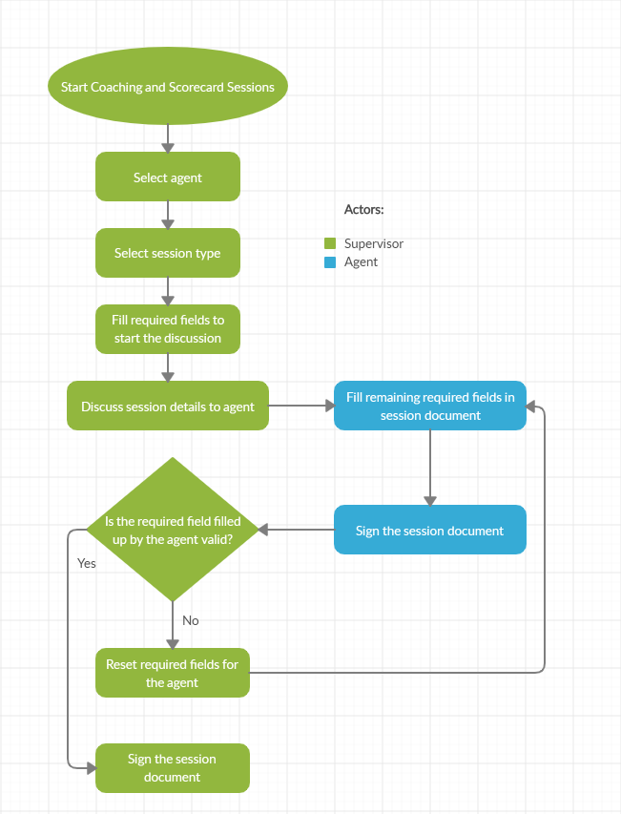
Process Workflow Coaching and Scorecard
The process for creating a coaching, scorecard and goal setting sessions
This is applicable for session types:
Mid-month Scorecard
Whole Month Scorecard
Goal Setting
Coaching

Slide 5
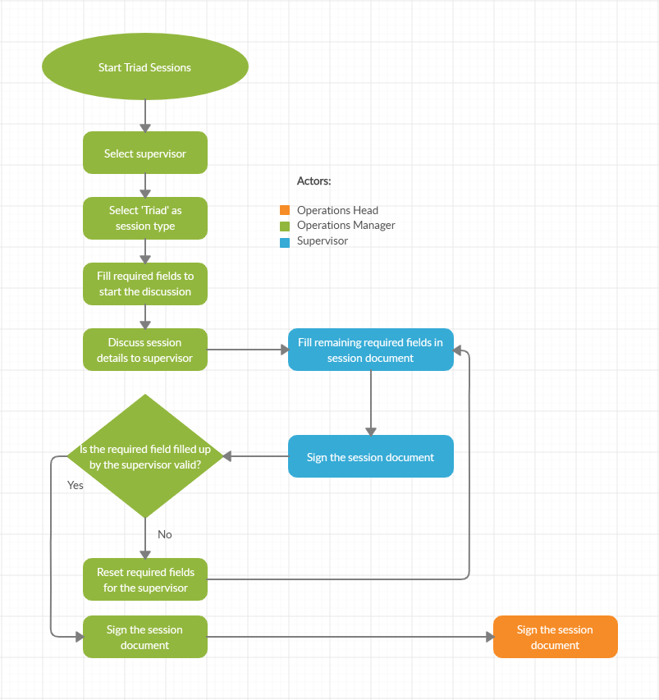
Process Workflow Triad Coaching
The process for creating a triad sessions
This is only applicable for session type ‘Triad‘

Slide 6
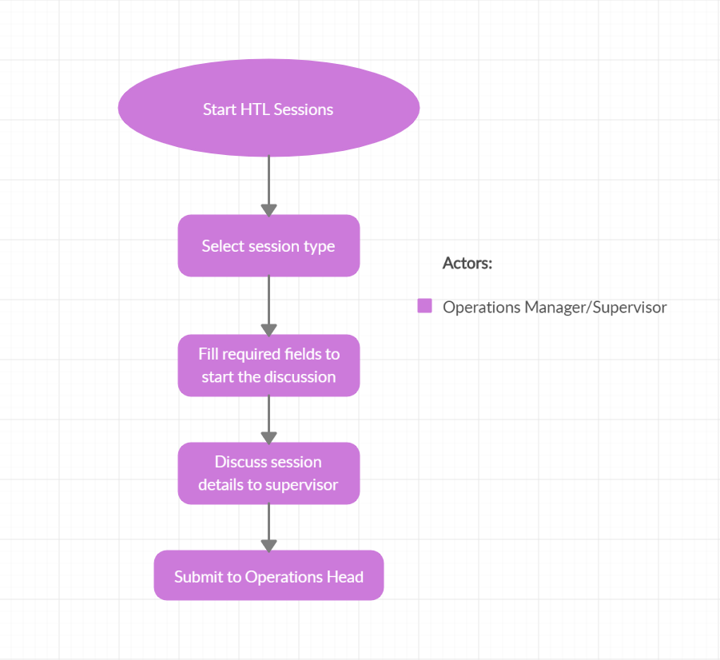
Process Workflow Heart of Team Leaders
The process for creating a HTL sessions
This is applicable for session types:
Meeting
Heartbeat
Floorwalk

Slide 7
Components

Slide 8
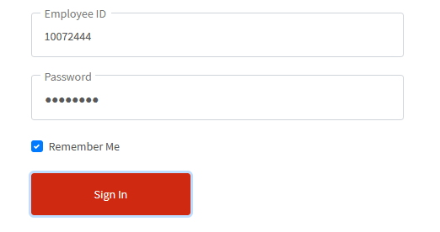
Login - Form
1. Username Input
Input your EID to this field
2. Password Input
Input your password to this field
The default password is simply ‘password’
3. Remember Me Toggle
If checked, enables the browser to remember last verified username and password
4. Submit Button
Submit your credential by clicking this button
If verified, you will be redirected to your dashboard
1
2
3
4

Slide 9
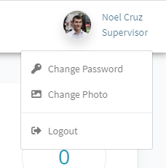
Dashboard - Header
1. User Picture
The profile picture of the user
Clicking this opens up the menu for 3 – 5 elements
2. User Information
Displays the user’s full name and his/her role
Clicking this opens up the menu for 3 – 5 elements
3. Change Password Option
Selecting this will trigger form for changing password
4. Change Photo Option
Selecting this will trigger form for changing photo
5. Logout Option
Selecting this option will logout the user’s account and will redirect to login page
1
2
3
4
5

Slide 10
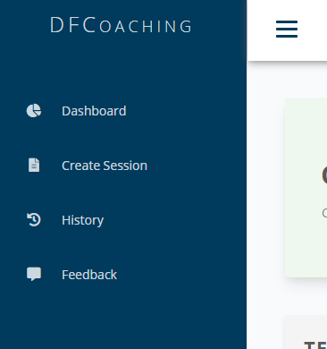

Dashboard - Sidebar
1
1. Hamburger Button
Toggle the button to collapse and uncollapse the sidebar menu
2. Dashboard Button
Redirects the user to his/her dashboard
3. Create Session Button
Clicking this button will trigger the form for creating session
4. History Button
Redirects the user to the table view of his/her session history
5. Feedback Button
Clicking this button will trigger the form for submitting feedback to the developers
6. Logout Button
Clicking this button will logout the user’s account and will redirect to login page
2
3
4
5
6

Slide 11
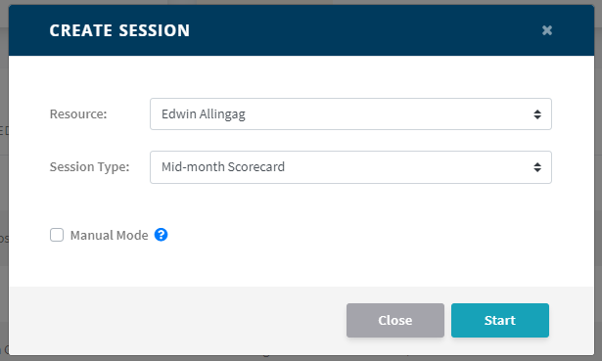
Dashboard – Create Session Form
1
1. Close Button
Closes the form
2. Resource Dropdown
User may select the agent he/she wants for the session
3. Session Type Dropdown
User may select the type of session
Only [Coaching] session type can be created without limit per week
4. Manual Toggle
By checking this toggle, the session will be pulling data to the manual data uploaded by the supervisor on the admin control panel
Only works if the selected session type is either [Mid-month Scorecard] or [Whole Month Scorecard]
5. Close Button
Closes the form
6. Start Button
Creates new session and redirects the user to the session document
Also notifies the agent for the new session
2
3
4
5
6

Slide 12
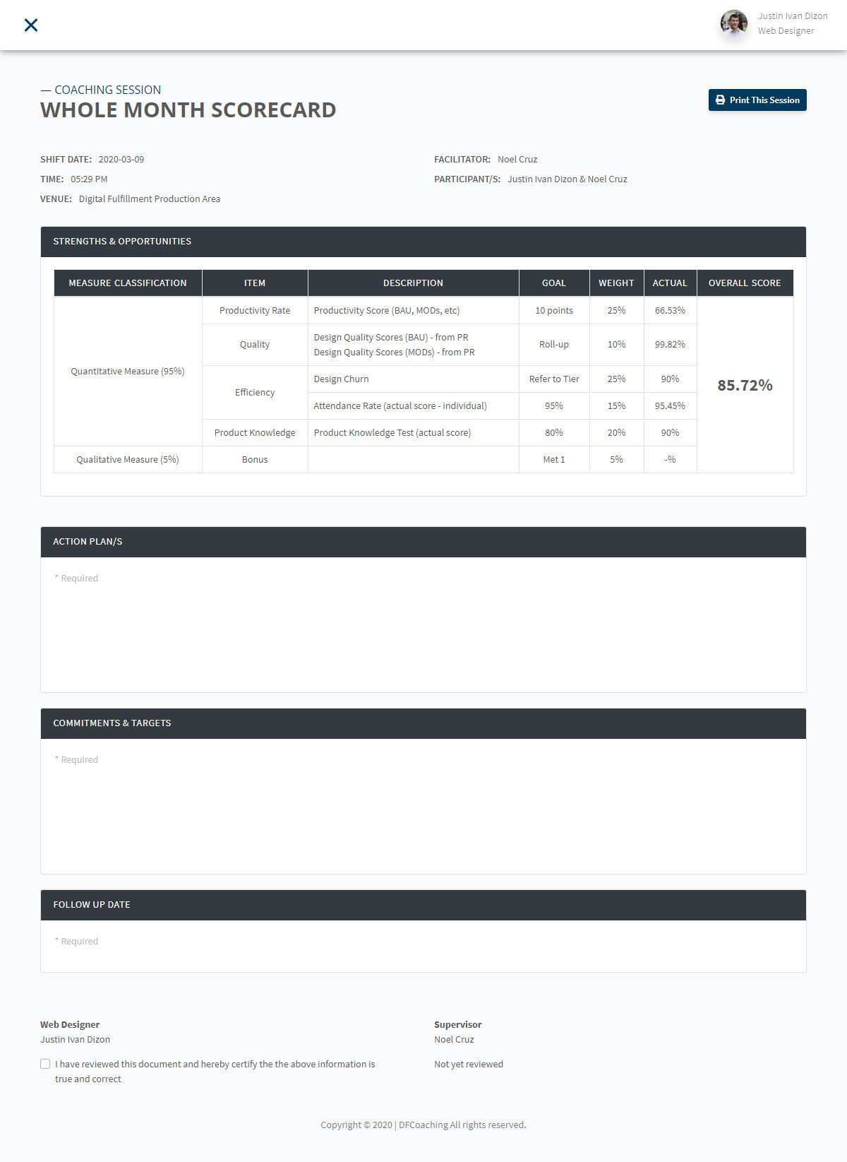
Session
1
2
1. Print Button
Clicking this will print the whole document
2. Session General Information
Displays the general information about this session document
3. Session Scorecard
Displays the scorecard associated by this session
Only displays if the session type is [Goal Setting], [Mid-month Scorecard] or [Whole Month Scorecard]
4. Session Fields
Pre-defined fields that needs to be filled by the participants
These fields are either required or optional depending on the type of the session selected
Can be reset by the employee one-level higher than the writer of the field (e.g. Supervisor can reset Agent’s fields, Manager can reset both Supervisor and Agent’s field, etc..)
Triggering reset will also remove the signature of the writer
5. Signatures
Document section where the participants signs the document
To sign, click the checkbox and it will ask for password verification, then finally click the Sign button
3
4
5

Slide 13
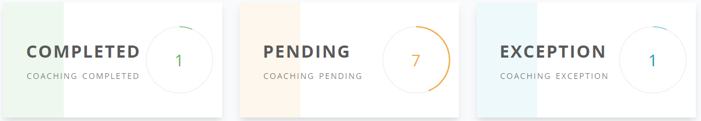
Components Dashboard Counter Cards
Let the user see the current count of completed sessions, pending sessions and excepted agents this week
(Available only to leaders)

Slide 14
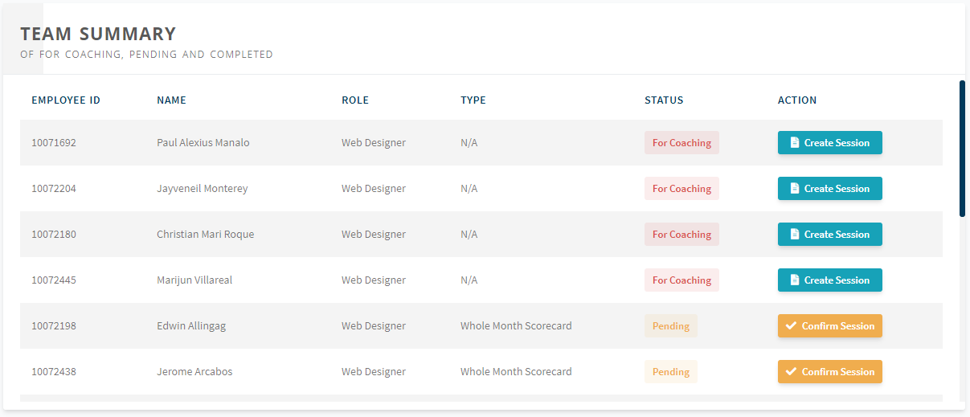
Components Dashboard Team Sessions
Let the user access team-level pending sessions and view its details and current status
(Available only to leaders with different component titles)
Titles
Supervisor: Team Summary
OM & OH: Teams Summary

Slide 15
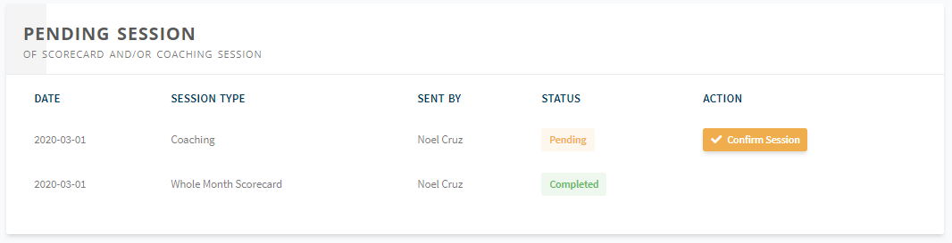
Components Dashboard User Sessions
Let the user access their pending sessions and view its details and current status
(Available to all roles with different component titles)
Titles
Agent: Pending Session
Supervisor: My Summary
OM & OH: Supervisors Summary

Slide 16
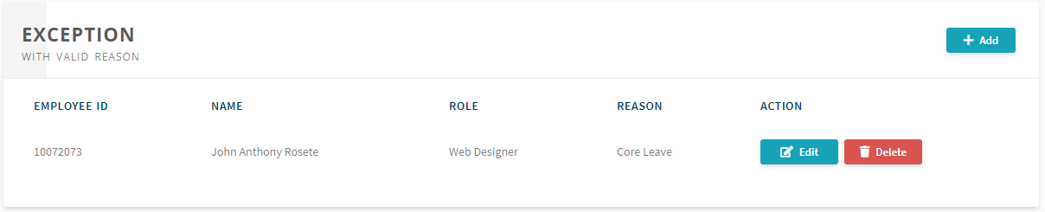
Components Dashboard Exceptions
Let the user view the agents who are excepted and their reason
(Available only to leaders, only supervisors can except their agents)

Slide 17
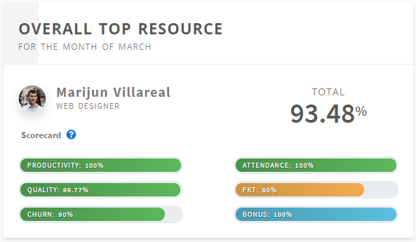
Components Dashboard Overall Top Resource
Let the user view the current overall top agent on his/her team
(Available only to supervisors)

Slide 18
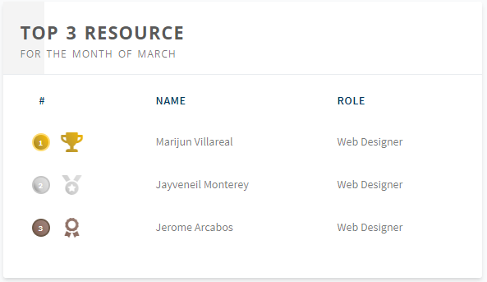
Components Dashboard Top 3 Resource
Let the user view the current top three agent ranking on his/her team
(Available only to supervisors)

Slide 19
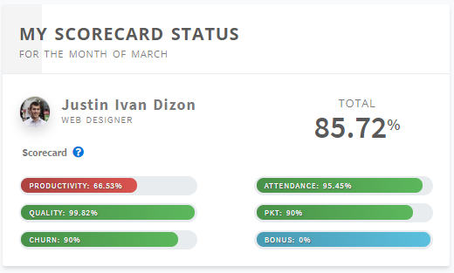
Components Dashboard My Scorecard Status
Displays the current scorecard summary of the agent based on the actual data
(Available only for agents)

Slide 20
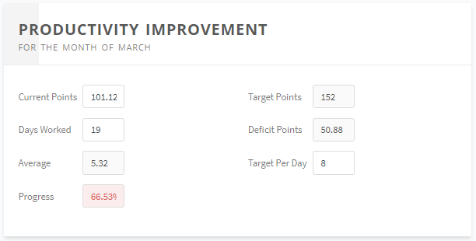
Components Dashboard Productivity Improvement
Let you simulate your productivity score
Agents can adjust the fields Current Points, Days Worked and Target Per Day
(Available only for agents)

Slide 21
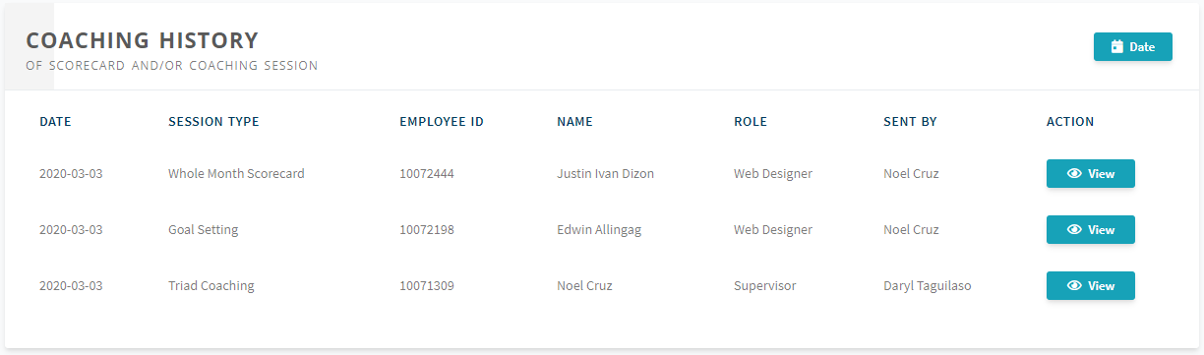
Components Sessions History
Let the user view all of the related sessions by the date range specified
Let the user review any session document on the list

Slide 22
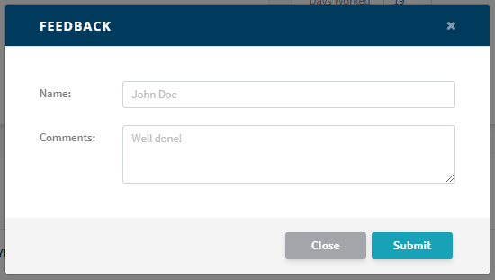
Components Sessions Feedback Form
Let the user submit any concern, suggestion or report any discovered software bugs to the developers

Slide 23
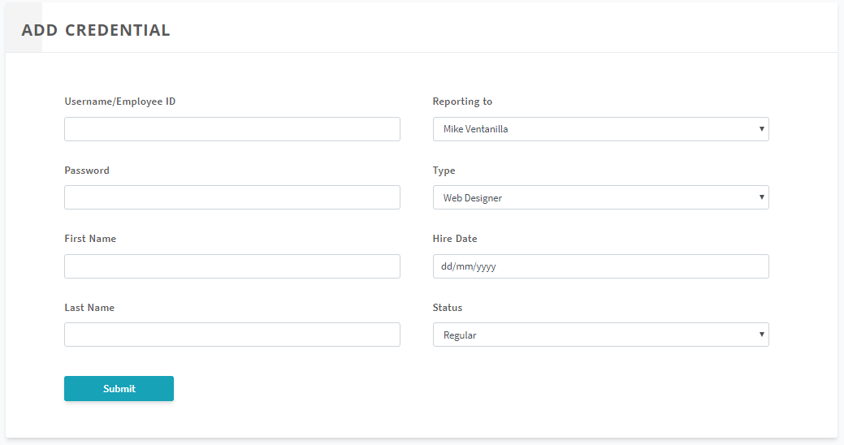
Components Admin Control Panel Add Credential
Let the administrator add new credential into the web application
All fields are required
Hire date helps the application determine the proficiency of the user

Slide 24
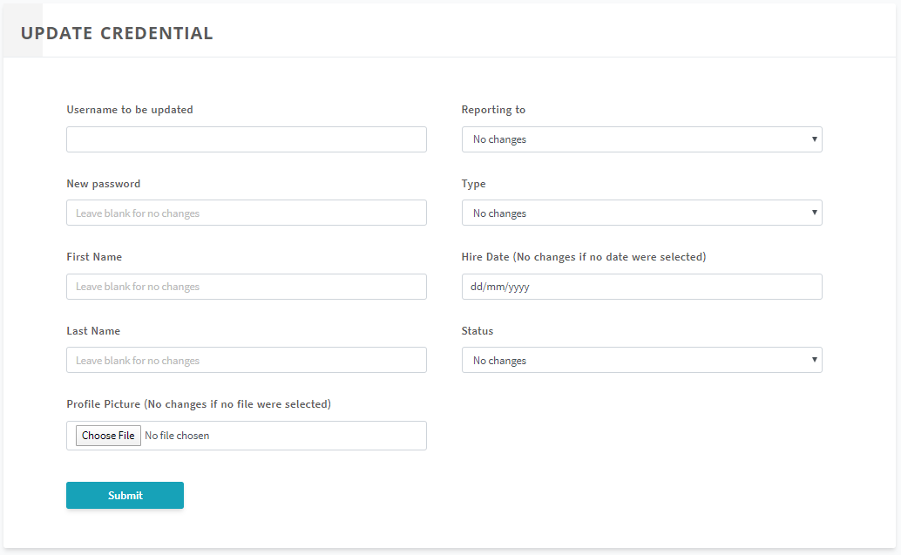
Components Admin Control Panel Update Credential
Let the administrator modify current credential into the web application
Username to be updated is the only required field
Hire date helps the application determine the proficiency of the user

Slide 25
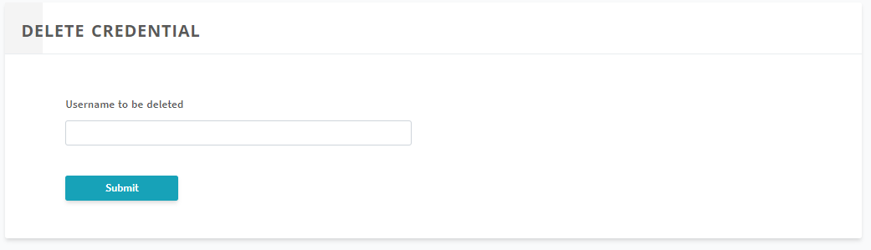
Components Admin Control Panel Delete Credential
Let the administrator delete current credential into the web application

Slide 26
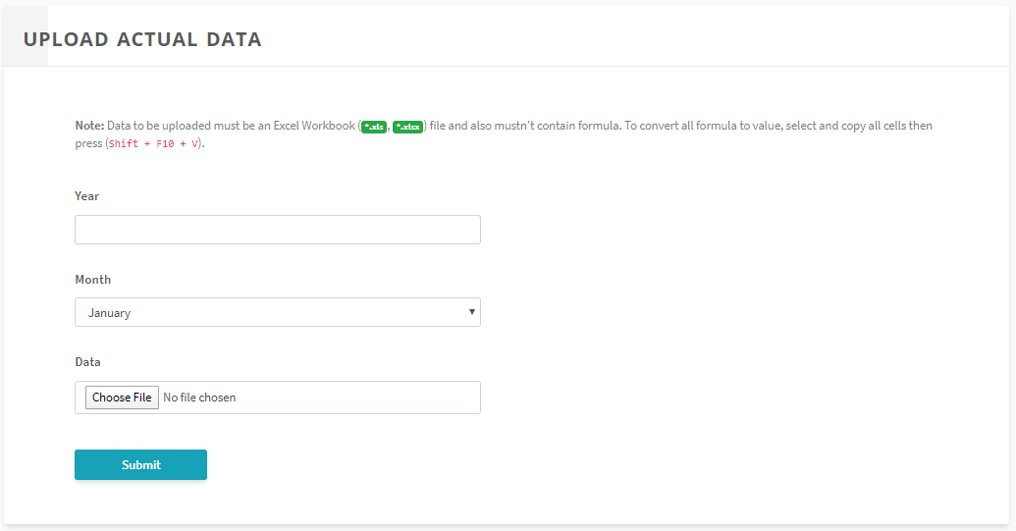
Components Admin Control Panel Upload Data
Let the administrator upload actual data to be read throughout the web application
Data field accepts only (*.xlsx) files
Excel file must be free of formula. To convert all formula to value, select all the cells on a worksheet then copy all, then press Shift + F10 + V.
The current extension of the Excel file provided was (*.xlsb) which is not supported and must be resaved as (*.xlsx)
Actual data is always displayed as the official data on all types of dashboard

Slide 27
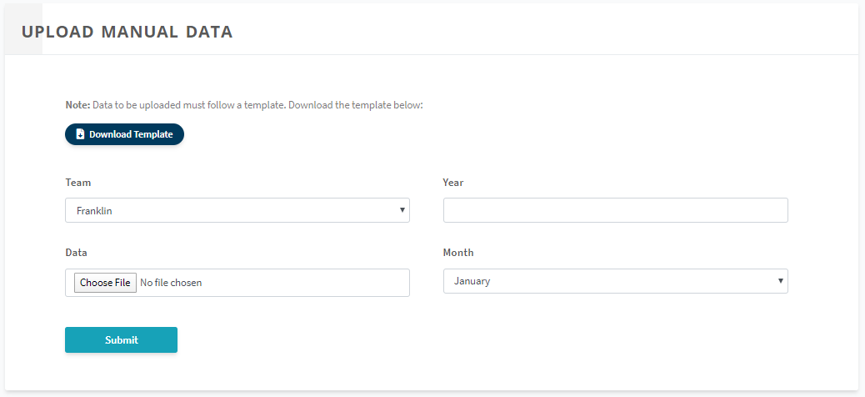
Components Admin Control Panel Upload Manual Data
Let the administrator upload manual data to be read in any scorecard session in manual mode
Data field accepts only (*.xlsx) files
Excel file follow the template we provided by clicking the ‘Download Template button’
The administrator must also specify which team does this data belong to
Manual data is never displayed as the official data on all types of dashboard

Slide 28
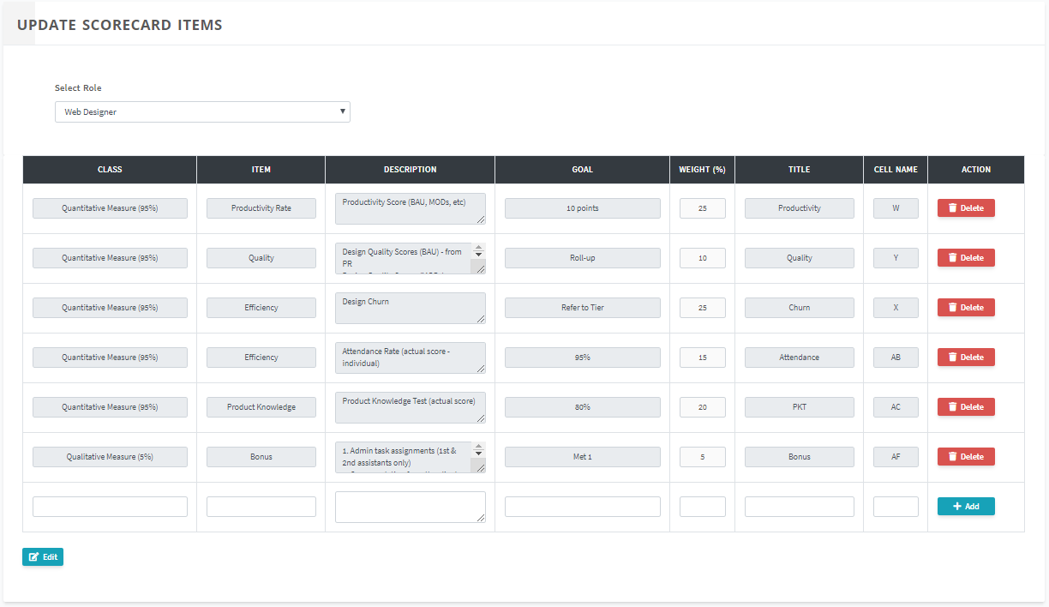
Components Admin Control Panel Update Scorecard Items
Let the administrator add/update/delete the current scorecard items on each roles
Title column is the definitive title for the scores displayed on dashboards
Cell Name column helps the web application to locate the actual score in the worksheet of an actual excel file by specifying the underlying cell name of the scorecard item inside the worksheet

Slide 29
Thank you!
A web application for coaching and scorecard process automation

